Slide 1
Software Design
Lecture 9

Slide 2
Content
Design Patterns
Creational Patterns
Factory Method
Prototype
Abstract Factory
Structural Patterns
Adapter
Bridge
Composite
Decorator
Proxy
Behavioral Patterns

Slide 3
References
Erich Gamma, et.al, Design Patterns: Elements of Reusable Object-Oriented Software, Addison Wesley, 1994, ISBN 0-201-63361-2.
Univ. of Timisoara Course materials

Slide 4
Classification of Design Patterns
Creational Patterns
deal with initializing and configuring classes and objects
how am I going to create my objects?
Structural Patterns
deal with decoupling the interface and implementation of classes and objects
how classes and objects are composed to build larger structures
Behavioral Patterns
deal with dynamic interactions among societies of classes and objects
how to manage complex control flows (communications)

Slide 5
Drawbacks of Design Patterns
Patterns do not lead to direct code reuse
Patterns are deceptively simple
Teams may suffer from patterns overload
Integrating patterns into a software development process is a human-intensive activity

Slide 6
Design Pattern Space
 |  | Purpose
 |  | Creational | Structural | Behavioral
Scope | Class | Factory Method | Adapter | Interpreter Template Method
 | Object | Abstract Factory Builder Singleton Prototype | Adapter Bridge Composite Decorator Facade Proxy Flyweight | Command Chain of Responsibility Strategy Visitor Iterator Mediator Memento Observer State

Slide 7
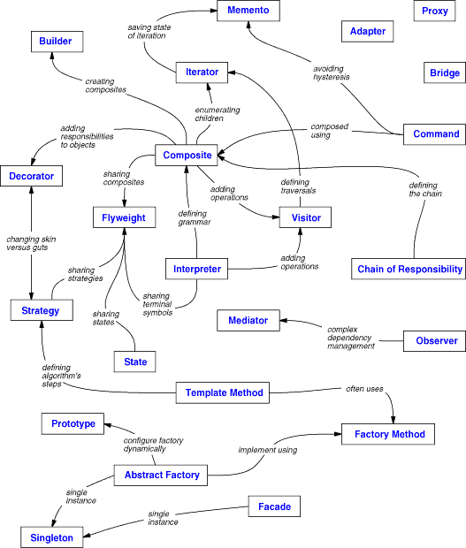
DP Relationships

Slide 8
Creational DP
Abstract instantiation process
System independent of how objects are created, composed, and represented
Class creational patterns use inheritance to vary class instantiation
Object creational patterns delegate instantiation to another object
Focus on defining small behaviors and combining into more complex ones

Slide 9
Recurring Themes
Encapsulate knowledge about which concrete classes the system uses
Hide how instances of these classes are created and put together

Slide 10
Advantages
Flexibility in what gets created
Who created it
How it was created and when
Configure system with “product” objects that vary in structure and functionality
Configuration can be static or dynamic
Create standard or uniform structure

Slide 11
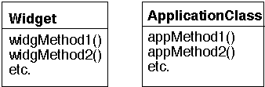
Let’s start simple...
class ApplicationClass {
public appMethod1() { ..
Widget w = new Widget();….
}…}
We can modify the internal Widget code without modifying ApplicationClass

Slide 12
Problems with Changes
What happens when we discover a new widget and would like to use in the ApplicationClass?
Multiple coupling between Widget and ApplicationClass
ApplicationClass knows the interface of Widget
ApplicationClass explicitly uses the Widget type
hard to change because Widget is a concrete class
ApplicationClass explicitly creates new Widgets in many places
if we want to use the new Widget instead of the initial one, changes are spread all over the code

Slide 13
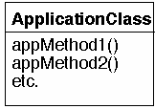
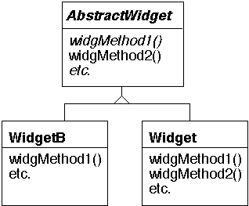
Apply “Program to an Interface”
ApplicationClass depends now on an (abstract) interface
But we still have hard coded which widget to create

Slide 14
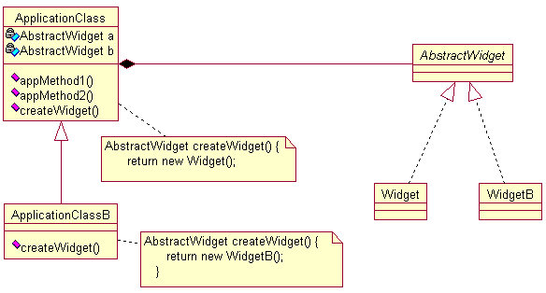
Use a Factory Method

Slide 15
Evaluation of Factory Method Solution
Explicit creation of Widget objects is not anymore dispersed
easier to change
Functional methods in ApplicationClass are decoupled from various concrete implementations of widgets
Avoid ugly code duplication in ApplicationClassB
subclasses reuse the functional methods, just implementing the concrete Factory Method needed
Disadvantages
create a subclass only to override the factory-method
can’t change the Widget at run-time

Slide 16
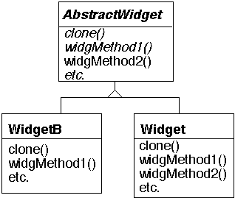
Solution 2: Clone a Prototype
Provide the Widgets with a clone method
make a copy of an existing Widget object

Slide 17
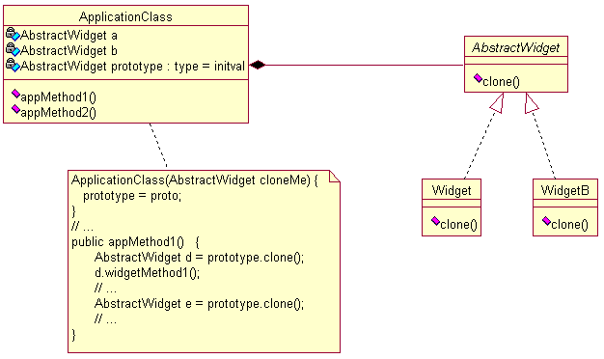
Using the Clone

Slide 18
Advantages
Classes to instantiate may be specified dynamically
client can install and remove prototypes at run-time
We avoided subclassing of ApplicationClass
Remember: Favor Composition over Inheritance!
Totally hides concrete product classes from clients
Reduces implementation dependencies

Slide 19
More Changes
What if ApplicationClass uses other "products" too...
e.g. Wheels, etc.
Each one of these stays for an object family
i.e. all of these have subclasses
Assume that there are restrictions on what type of Widget can be used with which type of Wheel or Cog
Factory Methods or Prototypes can handle each type of product but it gets hard to insure the wrong types of items are not used together

Slide 20
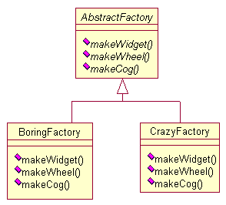
Solution: Create an Abstract Factory

Slide 21
Creational DP in Action
Maze Game
4
MapSite
enter()=0;
1
Maze
rooms
Room
Wall
Door
1 *
enter()
setSide()
getSide()
enter()
enter()
isOpen
roomNumber

Slide 22
Common abstract class for all Maze Components
enum Direction {North, South, East, West};
class MapSite {
public:
virtual void enter() = 0;
};
Meaning of enter() depends on what you are entering.
room → location changes
door → if door is open go in; else hurt your nose

Slide 23
Components of the maze – Maze
class Maze {
public:
void addRoom(Room*);
Room * roomNo(int) const;
private:
};
A maze is a collection of rooms. Maze can find a particular room given the room number.
roomNo() could do a lookup using a linear search or a hash table or a simple array.

Slide 24
Components of the maze – Wall & Door & Room
class Wall : public MapSite {
public:
Wall();
virtual void enter();
};
class Room : public MapSite {
public:
Room(int roomNo);
MapSite* getSide(Direction) const;
void setSide(Direction, MapSite*);
void enter();
private:
MapSite* sides[4];
int roomNumber;
}
class Door : public MapSite {
public:
Door(Room* = 0, Room* = 0);
virtual void enter();
Room* otherSideFrom(Room*);
private:
Room* room1;
Room* room2;
bool isOpen;
};

Slide 25
We want to play a game!
4
MapSite
MazeGame
enter()=0;
1
1
rooms
Room
Wall
Door
Maze
1 1..n
enter()
setSide()
getSide()
enter()
enter()
isOpen
1..n
roomNumber
Player

Slide 26
Creating the Maze
Maze* MazeGame::createMaze() {
Maze* aMaze = new Maze;
Room* r1 = new Room(1);
Room* r2 = new Room(2);
Door* theDoor = new Door(r1, r2);
aMaze->addRoom(r1);
aMaze->addRoom(r2);
r1->setSide(North, new Wall); r1->setSide(East, theDoor);
r1->setSide(South, new Wall); r1->setSide(West, new Wall);
r2->setSide(North, new Wall); r2->setSide(East, new Wall);
r2->setSide(South, new Wall); r2->setSide(West, theDoor);
}
r1
r2
The problem is inflexibility
hard-coding of maze layout
Pattern can make game creation more flexible... not smaller!

Slide 27
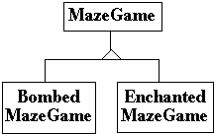
We want Flexibility in Maze Creation
Be able to vary the kinds of mazes
Rooms with bombs
Walls that have been bombed
Enchanted rooms
Need a spell to enter the door!

Slide 28
Idea 1: Subclass MazeGame, override createMaze
Maze* BombedMazeGame::createMaze() {
Maze* aMaze = new Maze;
Room* r1 = new RoomWithABomb(1);
Room* r2 = new RoomWithABomb(2);
Door* theDoor = new Door(r1, r2);
aMaze->addRoom(r1);
aMaze->addRoom(r2);
r1->setSide(North, new BombedWall);
r1->setSide(East, theDoor);
r1->setSide(South, new BombedWall);
r1->setSide(West, new BombedWall);
// etc...etc...
}
Lots of code duplication... :((

Slide 29
Idea 2: Use a Factory Method
4
MapSite
MazeGame
enter()=0;
makeWall()
createMaze()
1
Room
Wall
Door
enter()
setSide()
getSide()
enter()
BombedMazeGame
enter()
isOpen
makeWall()
roomNumber
BombedWall
return new BombedWall
enter()

Slide 30
Factory Method

Slide 31
Basic Aspects
Intent
Define an interface for creating an object, but let subclasses decide which class to instantiate.
Factory Method lets a class defer instantiation to subclasses
Also Known As
Virtual Constructor
Applicability
A class can’t anticipate the class of objects it must create
A class wants its subclasses to specify the objects it creates
Classes delegate responsibility to one of several helper subclasses

Slide 32
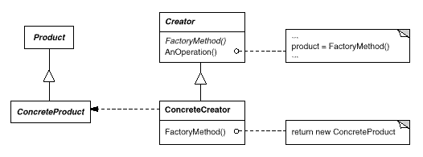
Structure

Slide 33
Participants & Collaborations
Product
defines the interface of objects that will be created by the FM
Concrete Product implements the interface
Creator
declares the FM, which returns a product of type Product.
may define a default implementation of the FM
ConcreteCreator
overrides FM to provide an instance of ConcreteProduct
Creator relies on its subclasses to define the factory method so that it returns an instance of the appropriate ConcreteProduct

Slide 34
Consequences
Eliminate binding of application specific classes into your code.
creational code only deals with the Product interface
Provide hooks for subclassing
subclasses can change this way the product that is created
Clients might have to subclass the Creator just to create a particular ConcreteProduct object.

Slide 35
Implementation Issues
Varieties of Factory Methods
Creator class is abstract
does not provide an implementation for the FM it declares
requires subclasses
Creator is a concrete class
provides default implementation
FM used for flexibility
Create objects in a separate operation so that subclasses can override it
Parametrization of Factory Methods
A variation on the pattern lets the factory method create multiple kinds of products
a parameter identifies the type of Product to create
all created objects share the Product interface

Slide 36
Parameterizing the Factory
class Creator {
public:
virtual Product * create(productId);
};
Product* Creator::create(ProductId id) {
if (id == MINE) return new MyProduct;
if (id == YOURS) return new YourProduct;
}
Product * MyCreator::create(ProductId id) {
if (id == MINE) return new YourProduct;
if (id == YOURS) return new MyProduct;
if (id == THEIRS) return TheirProduct;
return Creator::create(id); // called if others fail
}
selectively extend or change products that get created

Slide 37
Idea 3: Factory Method in Product
class Room : public MapSite {
public:
virtual Room* makeRoom(int no) {
return new Room(no);
}
// ...};
class RoomWithBomb : public Room {
public:
Room* makeRoom(int no) {
return new RoomWithBomb();
}
// ... };
// ...
class MazeGame {
protected:
Room* roomMaker;
// ...
public:
MazeGame(Room* rfactory) {
roomMaker = rfactory;
}
public Maze* CreateMaze() {
Maze aMaze = new Maze();
Room r1 = roomMaker->makeRoom( 1 );
// ...};
Make the product responsible for creating itself
e.g. let the Door know how to construct an instance of it rather than the MazeGame
The client of the product needs a reference to the "creator"
specified in the constructor

Slide 38
The Prototype Pattern

Slide 39
Basic Aspects
Intent
Specify the kinds of objects to create using a prototypical instance
Create new objects by copying this prototype
Applicability
when a client class should be independent of how its products are created, composed, and represented and
when the classes to instantiate are specified at run-time

Slide 40
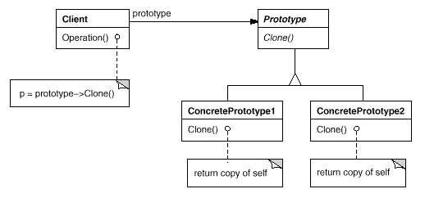
Structure

Slide 41
Participants & Collaborations
Prototype
declares an interface for cloning itself.
ConcretePrototype
implements an operation for cloning itself.
Client
creates a new object by asking a prototype to clone itself.
A client asks a prototype to clone itself.
The client class must initialize itself in the constructor
with the proper concrete prototype.

Slide 42
Consequences
Adding and removing products at run-time
Reduced subclassing
avoid parallel hierarchy for creators
Specifying new objects by varying values of prototypes
client exhibits new behavior by delegation to prototype
Each subclass of Prototype must implement clone
difficult when classes already exist or
internal objects don't support copying or have circular references

Slide 43
Implementation Issues
Using a Prototype manager
number of prototypes isn't fixed
keep a registry → prototype manager
clients instead of knowing the prototype know a manager
Initializing clones
heterogeneity of initialization methods
write an Initialize method
Implementing the clone operation
shallow vs. deep copy

Slide 44

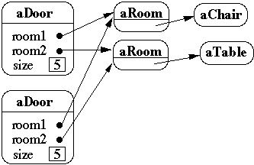
Shallow Copy vs. Deep Copy
Original
Shallow Copy

Slide 45
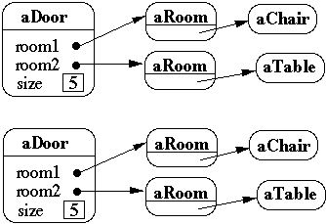
Shallow Copy vs. Deep Copy (2)
Original
Deep Copy

Slide 46
Cloning in C++ – Copy Constructors
class Door {
public:
Door();
Door( const Door&);
virtual Door* clone() const;
virtual void Initialize( Room*, Room* );
private:
Room* room1; Room* room2;
};
//Copy constructor
Door::Door ( const Door& other ) {
room1 = other.room1; room2 = other.room2;
}
Door* Door::clone() {
return new Door( *this );
}

Slide 47
Cloning in Java – Object clone()
protected Object clone() throws CloneNotSupportedException
Creates a clone of the object.
allocate a new instance and,
place a bitwise clone of the current object in the new object.
class Door implements Cloneable {
public void Initialize( Room a, Room b) {
room1 = a; room2 = b;
}
public Object clone() throws CloneNotSupportedException {
return super.clone();
}
Room room1, room2;
}

Slide 48
Solving the Maze Problem
class MazePrototypeFactory {
public:
MazePrototypeFactory(Maze*, Wall*, Room*, Door*);
virtual Maze* MakeMaze() const;
virtual Room* MakeRoom(int) const;
virtual Wall* MakeWall() const;
virtual Door* MakeDoor(Room*, Room*) const;
private:
Maze* _prototypeMaze;
Room* _prototypeRoom;
Wall* _prototypeWall;
Door* _prototypeDoor;
};
MazePrototypeFactory::MazePrototypeFactory (
Maze* m, Wall* w, Room* r, Door* d) {
_prototypeMaze = m; _prototypeWall = w;
_prototypeRoom = r; _prototypeDoor = d;
}
Wall* MazePrototypeFactory::MakeWall () const {
return _prototypeWall->Clone();
}
Door* MazePrototypeFactory::MakeDoor (
Room* r1, Room *r2) const {
Door* door = _prototypeDoor->Clone();
door->Initialize(r1, r2);
return door;
}
Creating a maze for a game………..
MazePrototypeFactory simpleMazeFactory
(
new Maze, new Wall, new Room, new Door
);
MazeGame game;
Maze* maze = game.CreateMaze(simpleMazeFactory);

Slide 49
Abstract Factory

Slide 50
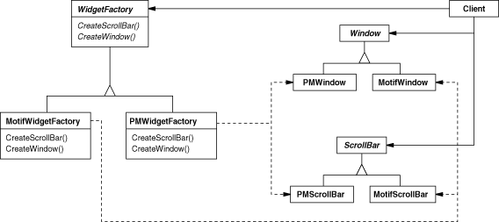
Introductive Example

Slide 51
Basic Aspects
Intent
Provide an interface for creating families of related or dependent objects without specifying their concrete classes
Applicability
System should be independent of how its products are created, composed and represented
System should be configured with one of multiple families of products
Need to enforce that a family of product objects is used together

Slide 52
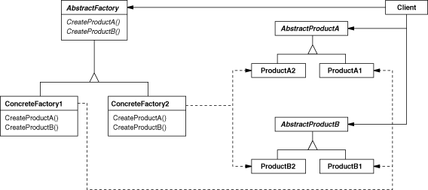
Structure

Slide 53
Participants & Collaborations
Abstract Factory
declares an interface for operations to create abstract products
ConcreteFactory
implements the operations to create products
AbstractProduct
declares an interface for a type of product objects
ConcreteProduct
declares an interface for a type of product objects
Client
uses only interfaces decl. by AbstractFactory and AbstractProduct
A single instance of a ConcreteFactory created.
create products having a particular implementation

Slide 54
What changes are supported?
ProductA3
ProductB3
AbstractProductC
ProductC2
ProductC1

Slide 55
Consequences
Isolation of concrete classes
appear in ConcreteFactories not in client's code
Exchanging of product families becomes easy
a ConcreteFactory appears only in one place
Promotes consistency among products
all products in a family change at once, and change together
Supporting new kinds of products is difficult
requires a change in the interface of AbstractFactory
... and consequently all subclasses

Slide 56
Implementation Issues
Factories as Singletons
to assure that only one ConcreteFactory per product family is created
Creating the Products
collection of Factory Methods
can be also implemented using Prototype
define a prototypical instance for each product in ConcreteFactor
Defining Extensible Factories
a single factory method with parameters
more flexible, less safe!

Slide 57
Creating Products
...using own factory methods
abstract class WidgetFactory {
public Window createWindow();
public Menu createMenu();
public Button createButton();
}
class MacWidgetFactory extends WidgetFactory {
public Window createWindow()
{ return new MacWidow() }
public Menu createMenu()
{ return new MacMenu() }
public Button createButton()
{ return new MacButton() }
}

Slide 58
Creating Products
abstract class WidgetFactory {
private Window windowFactory;
private Menu menuFactory;
private Button buttonFactory;
public Window createWindow()
{ return windowFactory.createWindow() }
public Menu createMenu();
{ return menuFactory.createWindow() }
public Button createButton()
{ return buttonFactory.createWindow() }
}
class MacWidgetFactory extends WidgetFactory {
public MacWidgetFactory() {
windowFactory = new MacWindow();
menuFactory = new MacMenu();
buttonFactory = new MacButton();
}
}
... using product's factory methods
subclass just provides the concrete products in the constructor
spares the reimplementation of FM's in subclasses

Slide 59
Singleton

Slide 60
Basics
Intent
Ensure a class has only one instance and provide a global point of access to it
Applicability
want exactly one instance of a class
accessible to clients from one point
want the instance to be extensible
can also allow a countable number of instances
improvement over global namespace

Slide 61
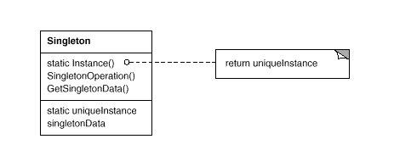
Structure of the Pattern
Put constructor in private/protected data section

Slide 62
Participants and Collaborations
Singleton
defines an Instance method that becomes the single "gate" by which clients can access its unique instance.
Instance is a class method (static member function in C++)
may be responsible for creating its own unique instance
Clients access Singleton instances solely through the Instance method

Slide 63
Consequences
Controlled access to sole instance
Permits refinement of operations and representation
Permits a variable (but precise) number of instances
Reduced global name space

Slide 64
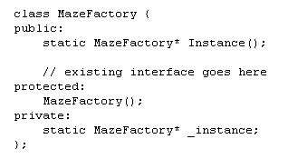
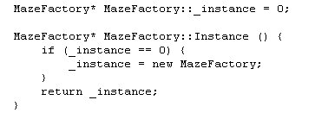
Making a single MazeFactory

Slide 65
Structural Patterns
Structural patterns are concerned with how classes and objects are composed to form larger structures.
Structural class patterns use inheritance to compose interfaces or implementations.
Rather than composing interfaces or implementations, structural object patterns describe ways to compose objects to realize new functionality.

Slide 66
Paying by PayPal
<?php
class PayPal {
public function __construct() {
// Your Code here //
}
public function sendPayment($amount) {
// Paying via Paypal //
echo "Paying via PayPal: ". $amount;
}
}
$paypal = new PayPal();
$paypal->sendPayment('2629');

Slide 67
Changes
sendPayment -> payAmount
COMMIT TO AN INTERFACE, NOT AN IMPLEMENTATION!
class PayPal {
public function __construct() {
// Your Code here //
}
public function sendPayment($amount) {
// Paying via Paypal //
echo "Paying via PayPal: ". $amount;
}
}

Slide 68
// Simple Interface for each Adapter we create
interface paymentAdapter {
public function pay($amount);
}
class paypalAdapter implements paymentAdapter {
private $paypal;
public function __construct(PayPal $paypal) {
$this->paypal = $paypal;
}
public function pay($amount) {
$this->paypal->sendPayment($amount);
}
}
// Client Code
$paypal = new paypalAdapter(new PayPal());
$paypal->pay('2629');

Slide 69
class paypalAdapter implements paymentAdapter {
private $paypal;
public function __construct(PayPal $paypal) {
$this->paypal = $paypal;
}
public function pay($amount) {
$this->paypal->payAmount($amount);
}
}

Slide 70
Adapter Pattern
Intent
Convert the interface of a class into another interface clients expect. Adapter lets classes work together that couldn't otherwise because of incompatible interfaces.
Also known as
Wrapper

Slide 71
Adapter Pattern
Applicability
you want to use an existing class, and its interface does not match the one you need.
you want to create a reusable class that cooperates with unrelated or unforeseen classes, that is, classes that don't necessarily have compatible interfaces.
(object adapter only) you need to use several existing subclasses, but it's impractical to adapt their interface by subclassing every one. An object adapter can adapt the interface of its parent class.

Slide 72
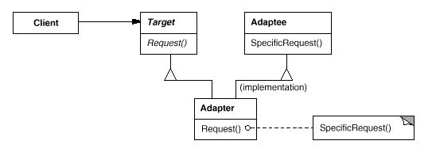
Adapter Pattern Structure
Class Adapter

Slide 73
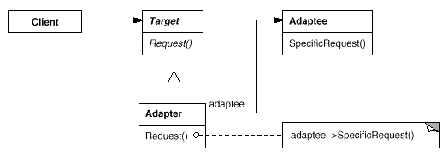
Adapter Pattern Structure
Object Adapter

Slide 74
Adapter Pattern - Participants
Target (Shape)
defines the domain-specific interface that Client uses.
Client (DrawingEditor)
collaborates with objects conforming to the Target interface.
Adaptee (TextView)
defines an existing interface that needs adapting.
Adapter (TextShape)
adapts the interface of Adaptee to the Target interface.

Slide 75
Adapter Pattern Consequences
Class Adapter
adapts Adaptee to Target by committing to a concrete Adapter class => a class adapter won't work when we want to adapt a class and all its subclasses.
lets Adapter override some of Adaptee's behavior, since Adapter is a subclass of Adaptee.
introduces only one object, and no additional pointer indirection is needed to get to the adaptee.

Slide 76
Adapter Pattern Concequences
Object Adapter
lets a single Adapter work with many Adaptees—that is, the Adaptee itself and all of its subclasses (if any). The Adapter can also add functionality to all Adaptees at once.
makes it harder to override Adaptee behavior. It will require subclassing Adaptee and making Adapter refer to the subclass rather than the Adaptee itself.

Slide 77
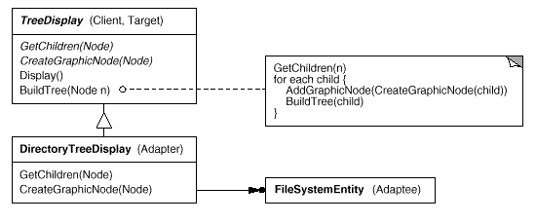
Other issues
How much adapting does Adapter do?
Pluggable adapters.
Using abstract operations

Slide 78
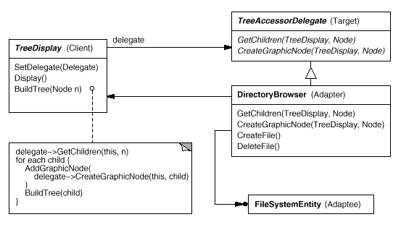
Pluggable adapters continued
Using delegate objects
Parameterized adapters

Slide 79
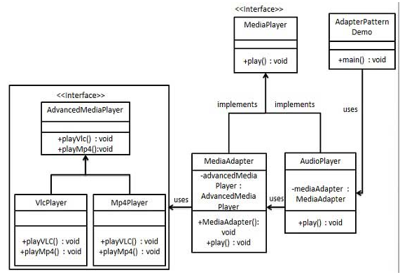
Another (bad!) Example
Interface Segreggation
Open Closed
How would you design it?

Slide 80
Composite Pattern

Slide 81
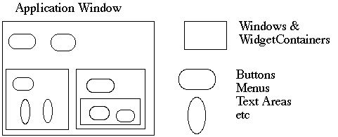
Motivation
GUI Windows and GUI elements
How does the window hold and deal with the different items it has to manage?
Widgets are different that WidgetContainers

Slide 82
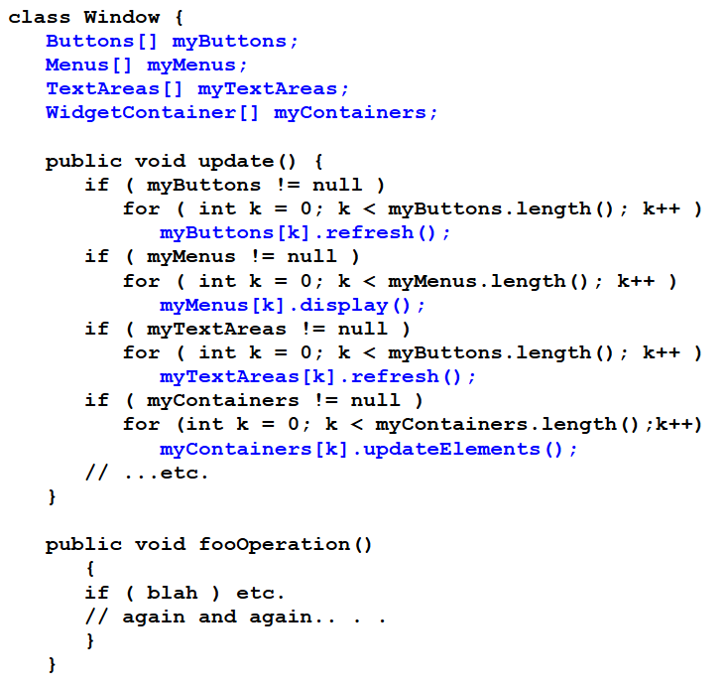
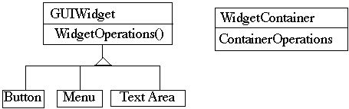
Implementation Ideas
Nightmare Implementation
for each operation deal with each category of objects individually
no uniformity and no hiding of complexity
a lot of code duplication
Program to an Interface
uniform dealing with widget operations
but still containers are treated different

Slide 83
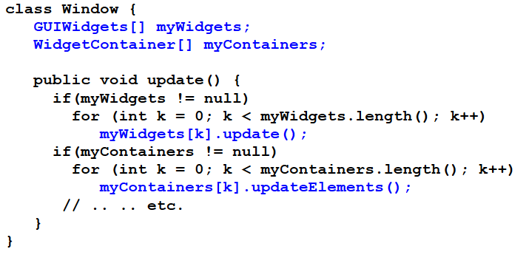
Program to an Interface

Slide 84
Basic Aspects of Composite Pattern
Intent
Treat individual objects and compositions of these object uniformly
Compose objects into tree-structures to represent recursive aggregations
Applicability
represent part-whole hierarchies of objects
be able to ignore the difference between compositions of objects and individual objects

Slide 85
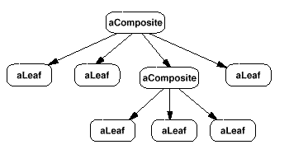
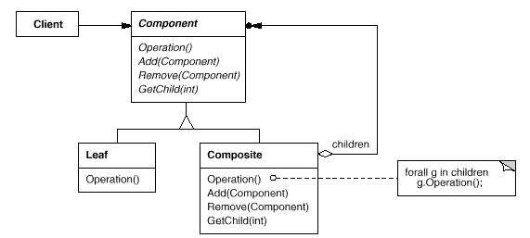
Structure

Slide 86
Participants & Collaborations
Component
declares interface for objects in the composition
implements default behavior for components when possible
Composite
defines behavior for components having children
stores child components
implement child-specific operations
Leaf
defines behavior for primitive objects in the composition
Client
manipulates objects in the composition through the Component interface

Slide 87
Consequences
Defines uniform class hierarchies
recursive composition of objects
Make clients simple
don't know whether dealing with a leaf or a composite
simplifies code because it avoids to deal in a different manner with each class
Easier to extend
easy to add new Composite or Leaf classes
Design excessively general
type checks needed to restrict the types admitted in a particular composite structure

Slide 88
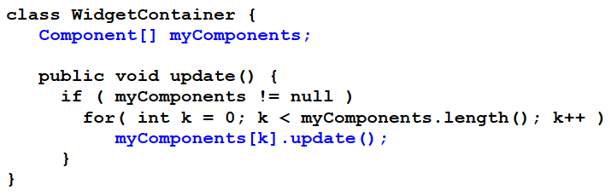
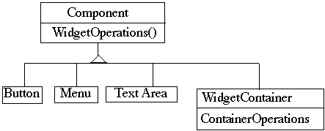
Applying Composite to Widget Problem
Component implements default behavior when possible
Button, Menu, etc override Component methods when needed
WidgetContainer will have to override all widget operations

Slide 89
Where to Place Container Operations ?
Adding, deleting, managing components in composite
should they be placed in Component or in Composite?
Pro-Transparency Approach
Declaring them in the Component gives all subclasses the same interface
All subclasses can be treated alike.
costs safety
clients may do stupid things like adding objects to leaves
getComposite() to improve safety.
Pro-Safety Approach
Declaring them in Composite is safer
Adding or removing widgets to non-Widget Containers is an error

Slide 90
Other Implementation Issues
Explicit parent references
simplifies traversal
place it in Component
the consistency issue
change parent reference only when add or remove child
Child Ordering
consider using Iterator
Who should delete components?
Composite should delete its children
Caching to improve performance
cache information about children in parents

Slide 91
Decorator Pattern
Changing the skin of an object

Slide 92
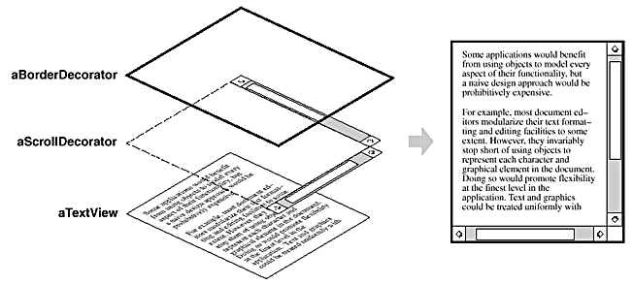
Motivation
A TextView has 2 features:
borders:
3 options: none, flat, 3D
scroll-bars:
4 options: none, side, bottom, both
Inheritance => How many Classes?
3 x 4 = 12 !!!
e.g. TextView, TextViewWithNoBorder&SideScrollbar, TextViewWithNoBorder&BottomScrollbar, TextViewWithNoBorder&Bottom&SideScrollbar, TextViewWith3DBorder, TextViewWith3DBorder&SideScrollbar, TextViewWith3DBorder&BottomScrollbar, TextViewWith3DBorder&Bottom&SideScrollbar, ... .....

Slide 93
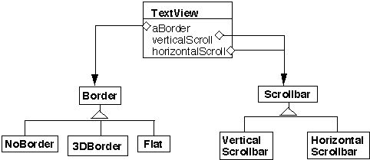
Solution 1: Use Object Composition

Slide 94
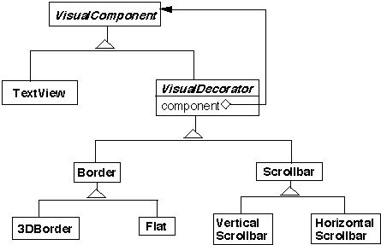
Solution 2: Change the Skin, not the Guts!
TextView has no borders or scrollbars!
Add borders and scrollbars on top of a TextView

Slide 95
Basic Aspects
Intent
Add responsibilities to a particular object rather than its class
Attach additional responsibilities to an object dynamically.
Provide a flexible alternative to subclassing
Also Known As
Wrapper
Applicability
Add responsibilities to objects transparently and dynamically
i.e. without affecting other objects
Extension by subclassing is impractical
may lead to too many subclasses

Slide 96
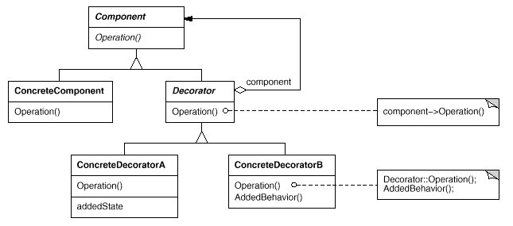
Structure

Slide 97
Participants & Collaborations
Component
defines the interface for objects that can have responsibilities added dynamically
ConcreteComponent
the "bases" object to which additional responsibilities can be added
Decorator
defines an interface conformant to Component's interface
for transparency
maintains a reference to a Component object
ConcreteDecorator
adds responsibilities to the component

Slide 98
Consequences
More flexibility than static inheritance
allows to mix and match responsibilities
allows to apply a property twice
Avoid feature-laden classes high-up in the hierarchy
"pay-as-you-go" approach
easy to define new types of decorations
Lots of little objects
easy to customize, but hard to learn and debug
A decorator and its component aren't identical
checking object identification can cause problems
e.g. if ( aComponent instanceof TextView )

Slide 99
Implementation Issues
Keep Decorators lightweight
Don't put data members in Component
use it for shaping the interface
Omitting the abstract Decorator class
if only one decoration is needed
subclasses may pay for what they don't need

Slide 100
Changing the Guts

Slide 101
Changing the "Guts" of an Object ...
Optimize
use an alternative algorithm to implement behavior (Strategy)
Alter
change behavior when object's state changes (State)
Control
"shield" the implementation from direct access (Proxy)
Decouple
let abstraction and implementation vary independently (Bridge)

Slide 102
Proxy Pattern

Slide 103
Loading "Heavy" Objects
Document Editor that can embed multimedia objects
MM objects are expensive to create ⇒ opening of document slow
avoid creating expensive objects
they are not all necessary as they are not all visible at the same time
Creating each expensive object on demand !
i.e. when image has to be displayed
What should we put instead?
hide the fact that we are "lazy"!
don't complicate the document editor!

Slide 104
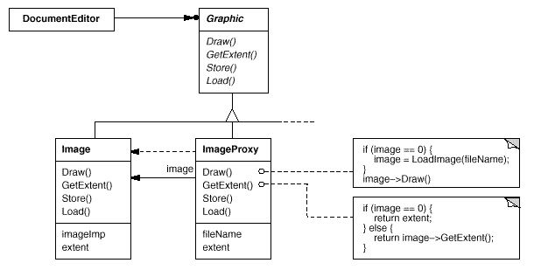
Idea: Use a Placeholder!
create only when needed for drawing
keeps information about the dimensions (extent)

Slide 105
Basic Aspects
Definition
proxy (n. pl prox-ies) The agency for a person who acts as a substitute for another person, authority to act for another
Intent
provide a surrogate or placeholder for another object to control access to it
Applicability: whenever there is a need for a more flexible or sophisticated reference to an object than a simple pointer
remote proxy … if real object is “far away”
virtual proxy … if real object is “expensive”
protection proxy … if real object is “vulnerable”
enhancement proxies (smart pointers)
prevent accidental delete of objects (counts references)

Slide 106
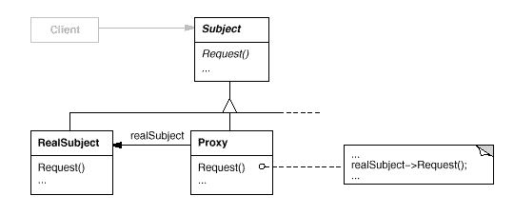
Structure

Slide 107
Participants
Proxy
maintains a reference that lets the proxy access the real subject.
provides an interface identical to Subject's
so that proxy can be substituted for the real subject
controls access to the real subject
may be responsible for creating or deleting it
Subject
defines the common interface for RealSubject and Proxy
RealSubject
defines the real object that the proxy holds place for

Slide 108
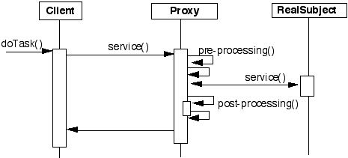
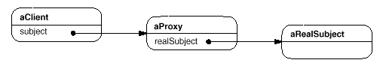
Collaborations

Slide 109
Consequences
Proxies introduce a level of indirection
used differently depending on the kind of proxy:
hide different address space (remote p.)
creation on demand (virtual p.)
allow additional housekeeping activities (protection, smart pointers)

Slide 110
Bridge Pattern

Slide 111
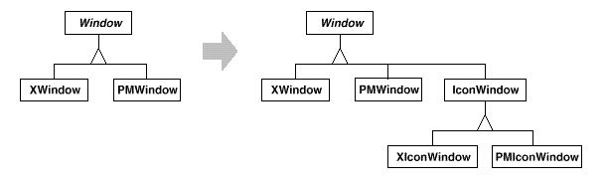
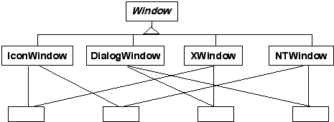
Inheritance that Leads to Explosion!

Slide 112
Basic Aspects of Bridge Pattern
Intent
decouple an abstraction from its implementation
allow implementation to vary independently from its abstraction
abstraction defines and implements the interface
all operations in abstraction call methods from its implementation obj.
In the Bridge pattern ...
... an abstraction can use different implementations
... an implementation can be used in different abstractions

Slide 113
Applicability
Avoid permanent binding btw. an abstraction and its implementation
Abstractions and their implementations should be independently extensible by subclassing
Hide the implementation of an abstraction completely from clients
their code should not have to be recompiled when impl. changes
Share an implementation among multiple objects
and this fact should be hidden from the client

Slide 114
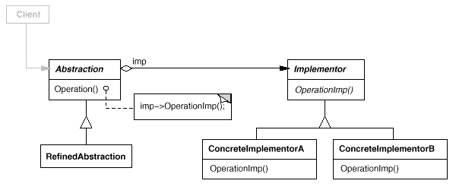
Structure

Slide 115
Participants
Abstraction
defines the abstraction's interface
maintains a reference to an object of type Implementor
Implementor
defines the interface for implementation classes
does not necessarily correspond to the Abstraction's interface
Implementor contains primitive operations,
Abstraction defines the higher-level operations based on these primitives
RefinedAbstraction
extends the interface defines by Abstraction
ConcreteImplementer
implements the Implementor interface, defining a concrete impl.

Slide 116
Consequences
Decoupling interface and implementation
implem. configurable and changeable at run-time
reduce compile-time dependencies
implement. changes do not require Abstraction to recompile
Improved extensibility
extend by subclassing independently Abstractions and Implementations
Hiding implementation details from clients
shield clients from implementations details
e.g. sharing implementor objects together with reference counting

Slide 117
Implementation
Only one Implementor
not necessary to create an abstract implementor class
degenerate, but useful due to decoupling
Which Implementor should I use ?
Variant 1: let Abstraction know all concrete implem. and choose
Variant 2: choose initially default implem. and change later
Variant 3: use an Abstract Factory
no coupling btw. Abstraction and concrete implem. classes

Slide 118
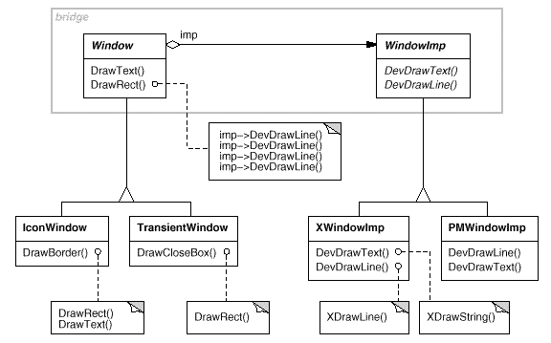
Windows Example Revisited

Slide 119
Adapter vs. Bridge
Common features
promote flexibility by providing a level of indirection to another object.
involve forwarding requests to this object from an interface other than its own.
Differences
Adapter resolves incompatibilities between two existing interfaces. It doesn't focus on how those interfaces are implemented, nor does it consider how they might evolve independently
Bridge links an abstraction and its implementations. It provides a stable interface to clients even as it lets you vary the classes that implement it.
The Adapter pattern makes things work after they're designed; Bridge makes them work before they are.

